Slide 1

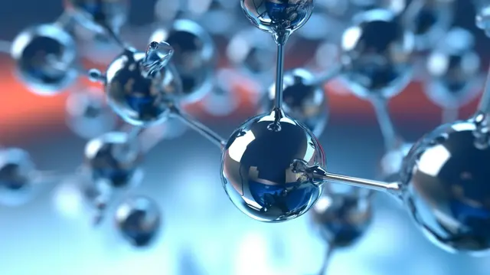
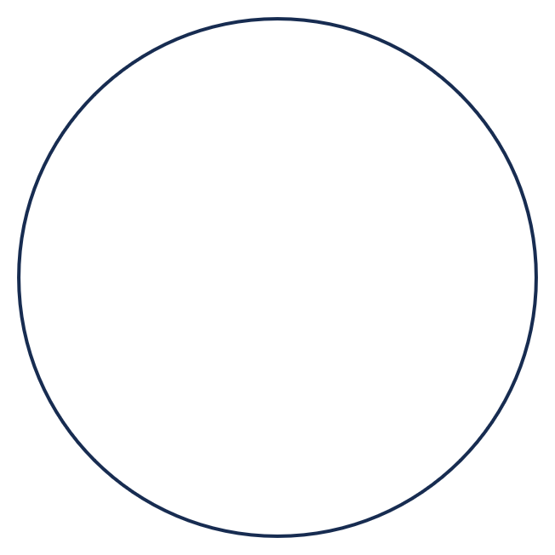




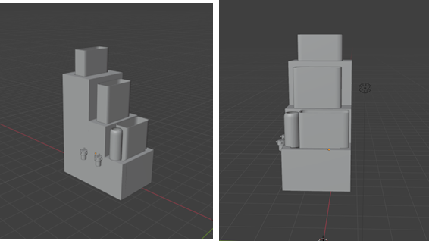




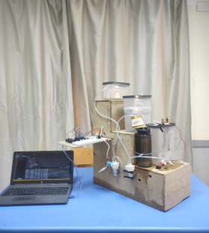




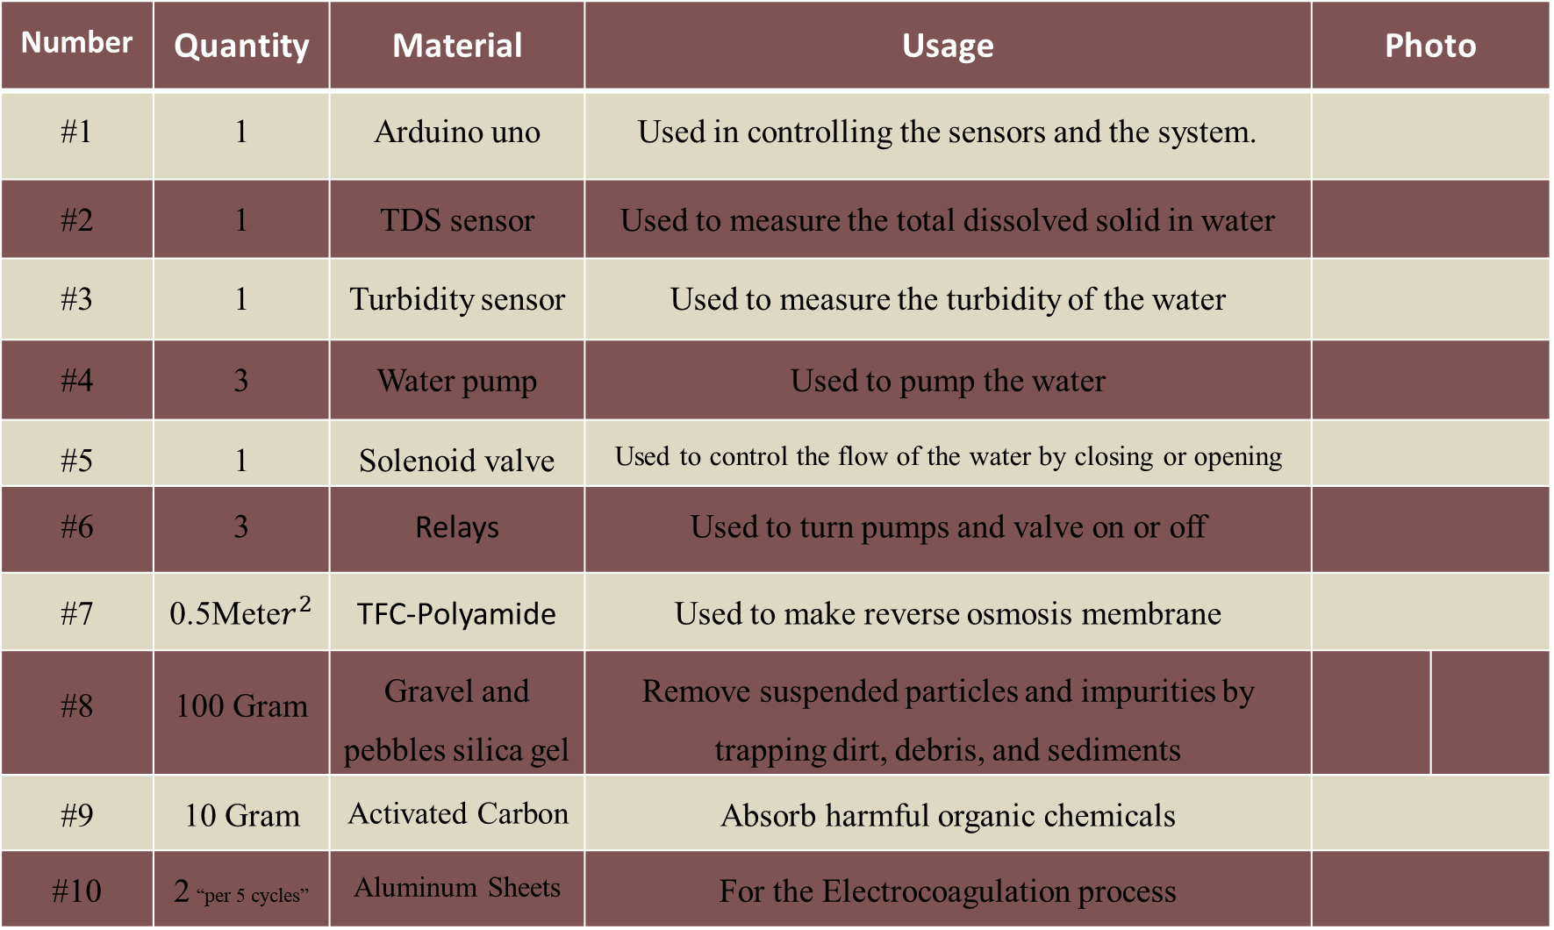
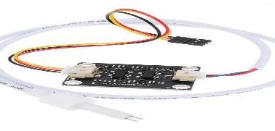
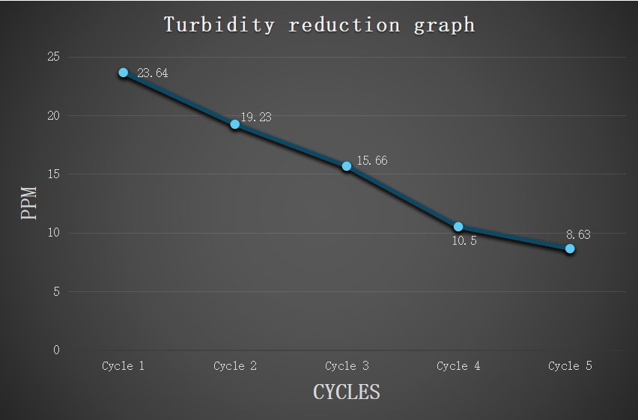
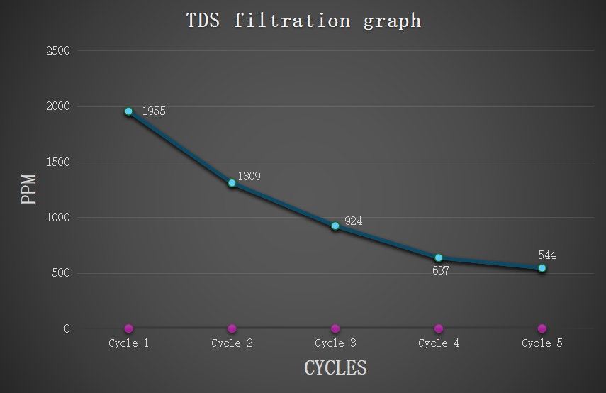
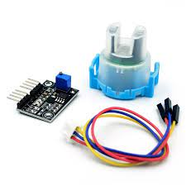
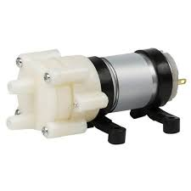

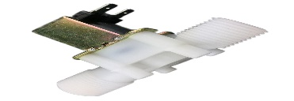
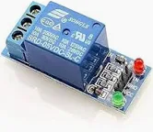

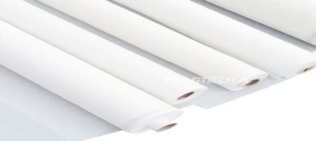
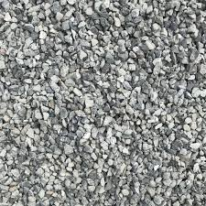
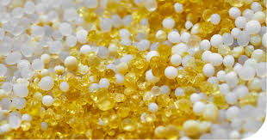

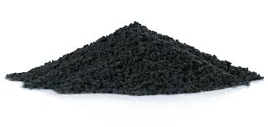
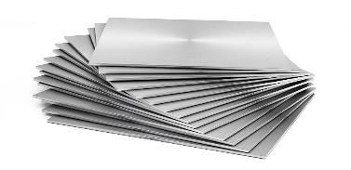

LemoLadder
Andrew Adel-Adham Sayed-George Nader-Yousef Tamer
STEM October 11ᵗʰ district - Grade 11 – 2ⁿᵈ semester - 2024/2025 - Group 29219
Keywords:
ABSTRACT
METHODS
After identifying the problem and defining its solution, let’s
talk about characteristics of our prototype:
Eco-Friendly Design:
The prototype is designed using recycled materials, making it highly eco-friendly. Plastic containers and hoses, along with old wooden boards, are used to build the structure and hold the filtration units. This not only reduces waste but also lowers production costs and promotes sustainability. All these things contribute to making the prototype of low cost.
2) High filtration efficiency:
The system demonstrates strong efficiency in treating Aluminum factory industrial discharge. It significantly reduces contaminants such as salinity, heavy metals (like aluminum and lead), organic biomaterials, large, suspended particles, and general impurities. This performance is achieved through a three-stage filtration process.
TDS filtration efficiency: It starts with 33.04%
in the 1st cycle and ends with 14.56% in the 5th
(last cycle), with an average filtration efficiency
of 22.18%.
Turbidity reduction efficiency: It
starts with 18.65% in the 1st cycle
and ends with 17.81% in the 5th
(last cycle), with an average filtration
efficiency of 18.25%.
3) The Three stages:
Stage One: A physical filtration layer made
of pebbles, gravel, silica gel, and activated
carbon removes large particles and sediments
and volatile organic compounds (VOCs).
Stage Two: The electrocoagulation stage
uses electric current to destabilize and remove
dissolved contaminants and heavy metals.
Stage Three: A reverse osmosis membrane
filters out fine particles, salts, and any remaining
impurities at the molecular level.
4) Energy consumed, capacity and time of
each cycle:
The wastewater that is filtered was 1100ml and it reaches after the 5th cycle about 1 liter (1000ml). This reduction in volume is because of many things, from them:
Filters retain an amount of water in them.
Deposits and flocs caused by electrocoagulation cause a reduction in volume.
A small amount of water is trapped in filter housings.
Energy consumed per each cycle decreases gradually from the 1st to the 5th cycle due to decreasing the resistance of water flowing as the filtration process progress during each cycle and as the time of system processing decrease due to a little decrease in the amount of water from one cycle to another.
According to table (2), about 8852 joules of energy were consumed in time of 2340 seconds (39 minutes) {Total time of system operation}. This is a very low energy consumption.
The primary goal of this project is to convert factory wastewater into water suitable for irrigating lemon trees. The appropriate total dissolved solids (TDS) content in lemon tree irrigation water ranges from 500 to 1,000 ppm. After five cycles, the TDS level in the contaminated water decreased from 1,955 ppm to 544 ppm, demonstrating the project's effectiveness in achieving its goal.
The following laws were used in constructing and testing:
1) P=IV (Power (in Watts) = Voltage (in Volts) x Current (in Amps))
2) P=W/T (Power (in Watts) = Energy consumed (in joules) / Time (in seconds).
3) Filtration efficiency (%)$=\frac{Initial value−Final value}{Initial value}∗100$
CONCLUSION
Egypt frankly encounters many dilemmas that are known as grand challenges, such as pollution fouling air, water, and soil and manage sources of clean water. The project this semester focuses mainly on reducing water pollution by creating a sustainable water purification system. Our project centers around the design of a closed-cycle water feedback filtration system. In Egypt, significant quantities of water are consumed by factories and are often discharged in environmentally harmful ways. The reuse of such water for environmentally beneficial applications is exceptional and necessary, particularly in light of current water scarcity issues. As one such application, the irrigation of lemon trees at our school was selected following the purification of wastewater originally discharged from an aluminum factory found in our city. This polluted industrial discharged water was found to contain high concentrations of dissolved salts, heavy metals, various impurities, and elevated turbidity levels. A three-stage purification system was developed to treat this water and render it suitable for irrigation. In the first stage, filtration was conducted using gravel, pebbles, activated carbon, and silica gel. The second stage involved electrocoagulation through the application of an electric current. In the third stage, reverse osmosis was implemented using a TFC polyamide membrane. The system was evaluated and proven to meet all design requirements, successfully achieving the project's primary goal. A purification efficiency of 72.17% in reducing total dissolved solids (TDS) and a 63.5% reduction in turbidity were recorded after five cycles of system operation, demonstrating the overall effectiveness of the treatment process.
After the materials for the prototype were obtained. The waste and recycled materials were used in the construction to preserve the environment, and of course, with the fulfillment and observation of the rubric that met design requirements:
Before starting in constructing the prototype the safety precautions have followed :such as
wearing gloves while working with electric circuits or chemicals, lab coats, and safety goggles were worn during working with chemicals.
A 3D model of the prototype was designed using Blender
to visualize the final shape before construction.
The frame for the prototype was then constructed to support it
and to allow it to depend on gravity in one of its stages.
Containers of 3 liters were used to ensure that the components of each stage would be supported, while a 2-liter container was used in the first stage to match the volume of polluted water.
The first stage was constructed by using small gravels, silica gel, and activated carbon, which were separated by layers of gauze.
The second stage was constructed using the electrocoagulation method,
with aluminum sheets used as the anode and cathode, and electricity was
Supplied by DC batteries.
In the third stage, the method used in modern filters which is
reverse osmosis (RO membranes)was applied using recycled
materials, which included a long plastic layer and a layer of plastic mesh
rolled together. A tube with pores and gauze around it
was placed in the middle to allow only water molecules to pass through
the membrane.
Three water pumps were installed: the first to absorb water from the valve in the container, the second to pump it directly into the RO membrane which required high pressure, and the third to complete the circulation of water from the lower stage to the higher one.
For the readings, a TDS sensor was used to measure salinity and heavy metals, and a turbidity sensor was used to measure turbidity.
Test Plan
Each cycle is required to be tested separately to measure the efficiency of each one.
Water is moved through the system to ensure no leakage occurs at any point.
Sensors are calibrated to ensure that the readings are close to the actual values.
4. The Arduino circuit is tested to ensure that it operates automatically
The problem of water pollution was addressed by the development of a water filtration system. The prototype is designed to efficiently remove pollutants from the water. The wastewater is aluminum industry’s wastewater discharge. After testing, it was found that the levels of the pollutants decreased which mean that the solution was effective to remove the pollutants. The prototype successfully reduced the concentration of the total dissolved solids (TDS) by 72.17%. The initial concentration of TDS was 1955ppm, and after filtration, it dropped to 544ppm. Water filter is designed to remove the harmful particles from the water. The filter is worked by 3 stages. The large particles are removed by pre-filter ‘physical filter’ that contains gravel and silica gel, also, activated carbon found in the first stage to ensure that the large particles are removed. The heavy metals are removed using the electrocoagulation that react with the heavy metals and precipitate it. Salinity is removed using the reverse osmosis, reverse osmosis removes the remaining pollutants that pass through the first and second stages. The aim of this project is using the treated water in irrigating lemon plants in our school. According to the results, our purified water is ideal for irrigating these plants.
RECOMMENDATION
INTRODUCTION
The performance and efficiency of the water purification system can be enhanced through several improvements. Key stages can be upgraded, and new technologies can be introduced to achieve better results. These changes will help to increase the system’s sustainability and make it more cost effective. Additionally, further research and testing can be conducted to optimize each stage of the process for a wider range of water conditions. There are some proposals to help develop it in real life, such as:
1) Add a cleaning system for the filters and RO membrane by pressure so it lasts longer without manual work.
2) Use ultraviolet light to kill bacteria, viruses and protozoa like E-coli and cholera.
3) AI-based Prediction: Later, add basic machine learning to predict filter life or detect unusual water contamination.
4) Use an original Arduino sensor for accurate readings and accurate results.
5) Use Fe₇₀Cr₁₇Ni₁₂Mo₂ where it can handle more electricity and filter more wastewater in shorter period of time than the aluminum sheets.
6) Increase the length of the RO membrane so the efficiency will increase, and more water is going to be filtered.
In this semester, Egypt’s Grand Challenges are being addressed through innovative student projects. Key issues are being tackled, such as waste recycling for economic and environmental benefits, pollution reduction in air, water, and soil, the effective use of arid lands, improved access to clean water, and the expansion of industrial and agricultural sectors.
Among these, water pollution is being treated as one of the most critical problems. It is caused when harmful substances are released into natural water bodies, making them unsafe for human use and damaging to aquatic ecosystems. Contaminants such as toxic waste, oil, and disease-causing microorganisms are often responsible. For this reason, water pollution is considered a major environmental issue worldwide.
Our project has been inspired by two previously implemented solutions:
• The Carlsbad Desalination Plant (California, USA): Reverse osmosis technology is used to convert seawater into drinking water, producing around 50 million gallons per day. Seawater is pre-treated to remove sediments, then passed through RO membranes to eliminate salinity and heavy metals such as lead and mercury. • Strength: Clean water is provided daily, and harmful substances are efficiently removed.
• Weakness: High costs and energy usage lead to expensive water and increased environmental impact.
• The Ras Al-Khair Desalination Plant (Saudi Arabia): A combination of multi-effect distillation (MED) and reverse osmosis (RO) is used to produce over 1 million cubic meters of potable water daily.
• Strength: Large-scale water production helps combat water scarcity.
• Weakness: High energy demands and negative environmental effects from brine disposal.
Our prototype has been developed to overcome the weaknesses found in the previous solutions. It focuses on the removal of salinity, sediments, and heavy metals. A pre-treatment stage is used to eliminate large particles like sediments, followed by RO membranes and electrocoagulation for further purification.
• Filtration efficiency has been improved.
• Costs have been reduced using cheaper materials and optimized methods.
• Energy consumption has been lowered by using gravity to assist water flow in several stages.
It meets all the design requirements, from them: • It is designed as a closed-cycle system.
• It treats aluminum factory wastewater with a TDS level of 1955 ppm and turbidity level of 23.64 ntu (turbid water) • It achieves high purification efficiency at low cost and minimal energy use..
Cycle no. | 1 | 2 | 3 | 4 | 5
Duration | 8 min | 7 min & 54 sec | 7 min & 48 sec | 7 min & 42 sec | 7 min & 36 sec
Cycle no. | 1 | 2 | 3 | 4 | 5
Energy Consumed | 1840.7 J | 1805.8 J | 1770.4 J | 1735.3 J | 1700.1 J
RESULTS
LITERATURE CITED
Negative results
1. Firstly, the mechanism of the cycling system wasn’t stable and was leaking a lot of water, and this had negative effects on the efficiency of the water cycle inside the system Solution: The problem was solved by using wax
Secondly, a cotton layer was added as one of the filtering layers. The water that passed through this stage was affected negatively and acted as an impediment Solution: This layer was removed and replaced with medical gauze
Thirdly, the sensor’s reading was unstable and gave different readings in the clear water and in the polluted one to Solution: A standard solution was used in calibrating the sensors’ salinity, turbidity, and etc.
Positive results
Before starting the cycles, the TDS sensor and turbidity sensor were used in measuring the turbidity and the salinity.
The readings of the sensors were noticed to be
1956 PPM TDS 23.65 NTU turbidity (with its decimals)
MATERIALS
Learning transfer | The application
CH.2.08 and 2.09 | Faraday’s Law of Electrolysis supports the electrocoagulation process by quantifying the relation between electric current and metal removal is studied to help in constructing the second filter stage
PH.2.15 | The focus is on how diodes function in AC/DC circuits, especially in one-way current flow and rectification are learnt. The prototype applies this concept when using relays and protection diodes to safely switch high-power devices such as pumps without damaging the Arduino. These diodes ensure that current flows only in the desired direction.
ME.2.05 | This learning outcome is centered on understanding how power relates to energy transfer, specifically through equations like P = W/t and P = FV. It emphasizes using these relationships to analyze systems and quantify energy flow. In the prototype, this understanding was applied by using power values and the operation time to calculate the total energy consumed by the pumps and valves, following the principal E = P × t.
ES.2.10 | The water cycle gives an image about a closed-loop water treatment system, because it shows how water is naturally used, purified and reused.
PH.2.16 | This learning outcome is about understanding how bipolar transistors are used as digital switches in electronic circuits. In the prototype, this concept was used by using an Arduino and relay modules where electrical signals were used to control pumps and valves. Like how transistors switch a circuit on or off, relays were used to do the same task automatically and the switching logic was programmed based on sensor inputs.
CS.2.05 | Making mobile applications through using JavaScript is studied in this learning transfer which will be used in making mobile application that receives the readings of the sensors.
ACKNOLEDGEMENT
Graph .2
Graph .1
First, we thank god for his guidance throughout this project. We are sincerely grateful to
Dr. Ahmed Al-Awny (School Principal)
Dr. Sally Hussien (School Deputy) for their encouragement
Mr. Mohamed Abdelrahman, Dr. Dalia Abosedera
Mr. Mahmoud Obada for their guidance.
Mr. Essam (Lab Assistant) for his support.
Dr. Heba Momtaz from MUST University for her helpful advice.
Dr. Zenab chemistry teacher
ANALYSIS
Egypt grapples with significant water pollution challenges, primarily due to industrial wastewater discharges. According to a study published on (Academia.edu), approximately 80% of the country's industrial effluent is discharged untreated into the Nile River, canals, wells, municipal sewage systems, and ultimately the Mediterranean Sea. This volume of untreated industrial waste contributes to the degradation of water quality and poses serious environmental and public health risks. The industrial sector in Egypt comprises around 329 major industries, many of them are concentrated in urban areas such as Cairo. These industries discharge an estimated 2.5 million cubic meters per day of untreated effluent into water bodies. Notably, 50% to 64% of industrial activity is in Cairo, exacerbating the pollution levels in the Nile and surrounding waterways. In response to these challenges, Egypt established a national monitoring network in 2021 under the Egyptian Environmental Affairs Agency (EEAA). The previous statistics underscore the urgent need for comprehensive water management strategies, stricter pollution controls, and enhanced public awareness to address Egypt's water pollution and scarcity issues.
FOR FURTHER INFORMATION
andrew.2923019@stemoctober2.moe.edu.eg
adham.2923008@stemoctober2.moe.edu.eg
george.2923028@stemoctober2.moe.edu.eg
youssef.2923071@stemoctober2.moe.edu.eg

